Slide 1

RUNGTA COLLEGE OF DENTAL SCIENCES & RESEARCH
TITLE OF THE TOPIC
Apexogenesis & Apexification
DEPARTMENT OF CONSERVATIVE DENTISTRY AND ENDODONTICS

Slide 2
Specific learning Objectives
At the end of this presentation the learner is expected to know
Core areas* H | Domain ** | Category #
Defination indications and contraincations medicaments used | Cognitive | Must know
Diagnosis,types | Psychomotor | Nice to know
One visit apexification | Affective | Desire to know
*Subtopic of importance
** Cognitive, Psychomotor or Affective
# Must know , Nice to know & Desire to know

Slide 3
CONTENTS
INTRODUCTION
DEFINITION- OPEN APEX
CAUSES OF OPEN APEX
TYPES OF OPEN APEX
STAGES OF ROOT DEVELOPMENT
PROBLEMS ASSOCIATED WITH IMMATURE APEX
DIAGNOSIS AND TREATMENT ASSESSMENT
APEXOGENESIS: INDICATION, CONTRAINDICATION
GOALS OF APEXOGENESIS
PROCEDURE
FOLLOW UP
APEXIFICATION: INDICATIONS, CONTRAINDICATIONS, OBJECTIVES
VARIOUS APPROACHES
ONE VISIT APEXIFICATION
RESULTS OF APEXIFICATION BY FRANK
MEDICAMENTS USED: CALCIUM HYDROXIDE, MTA, BIODENTINE
CONCLUSION
REFERNCES

Slide 4
Physical and chemical properties
Ph
MTA has a pH similar to that of calcium hydroxide of 12.5
This similarity with calcium hydroxide is thought to contribute to its inductive potential and the resultant hard tissue formation
The pH of MTA as it set was measured with a pH meter using a temperature-compensated electrode.

Slide 5
2. Sealing ability & marginal adaptation
The quality of apical seal for different retrograde materials has been assessed by different research groups, based on the degree of penetration by
Dye
radio-isotope
Bacterial
electro-chemical means and
fluid filtration techniques

Slide 6
MTA is also associated with less overfills and the superior outcome associated with the material is observed with or without blood contamination of the root cavities.
In a study carried out by Fischer et al.1998, using bacterial leakage model, the time period in which materials began leaking was 10-63 days for amalgam, 24- 91 days for IRM.
MTA did not begin to leak till day 49.
The superior sealing ability of MTA is thought to be due to the setting expansion it undergoes in moist environment

Slide 7
3. COMPRESSIVE STRENGTH
MTA has a relatively low compressive strength; however, this does not compromise its success as it is used in situations that experience low compressive forces.
Sluyk et al..(1998) studied setting properties of MTA and found that MTA reached its maximum resistance level if left undisturbed for 72 hours before placement of a permanent restoration.

Slide 8
4. INDUCTIVE POTENTIAL
Torabinejad et al. and colleagues 1995 used infected premolars in two-year old beagle dogs, which were prepared to receive gutta-percha root-fillings
The root fillings were left to contaminate by means of open access cavities and subsequently underwent root resection and retrograde fillings with either MTA or amalgam
Although periosteum and new bone formation were found in the presence of both materials, histologic findings at 10-18 weeks post-surgery confirmed the formation of cementum exclusively over the root ends with MTA, which included the MTA itself.

Slide 9
5. Cytotoxicity
An in vitro study conducted by Osorio et al. in 1998 compared different root canal sealers and root end filling materials using two assay systems and two different mammalian fibroblast cell line .
Their conclusions were based on the fact that if a material exhibits a strong cytotoxicity in cell culture tests, it is very likely to do so in living tissue. Of the materials tested, MTA was the least cytotoxic.

Slide 10
Mineral trioxide aggregate apexification: a 20-year case review
Aust Endod J 2021; 47: 335–342
This report describes the long-term treatment outcome of mineral trioxide aggregate (MTA) apexification managed with late term surgical intervention. A seven-year-old male reported with swelling and suppuration associated with a traumatised maxillary left central incisor (#21).
After palliative treatment and MTA apexification procedures, the incisor demonstrated normal function during a 14.5-year period with radiographic evidence of atypical radicular elongation.
Seventeen years after initial treatment, the patient presented with mid-plate buccal swelling and surgical treatment was completed involving root resection, biopsy of a spherical mineralised tissue specimen and placement of MTA root-end filling. Periapical healing and normal tooth function was evident at the 20-year review.

Slide 11
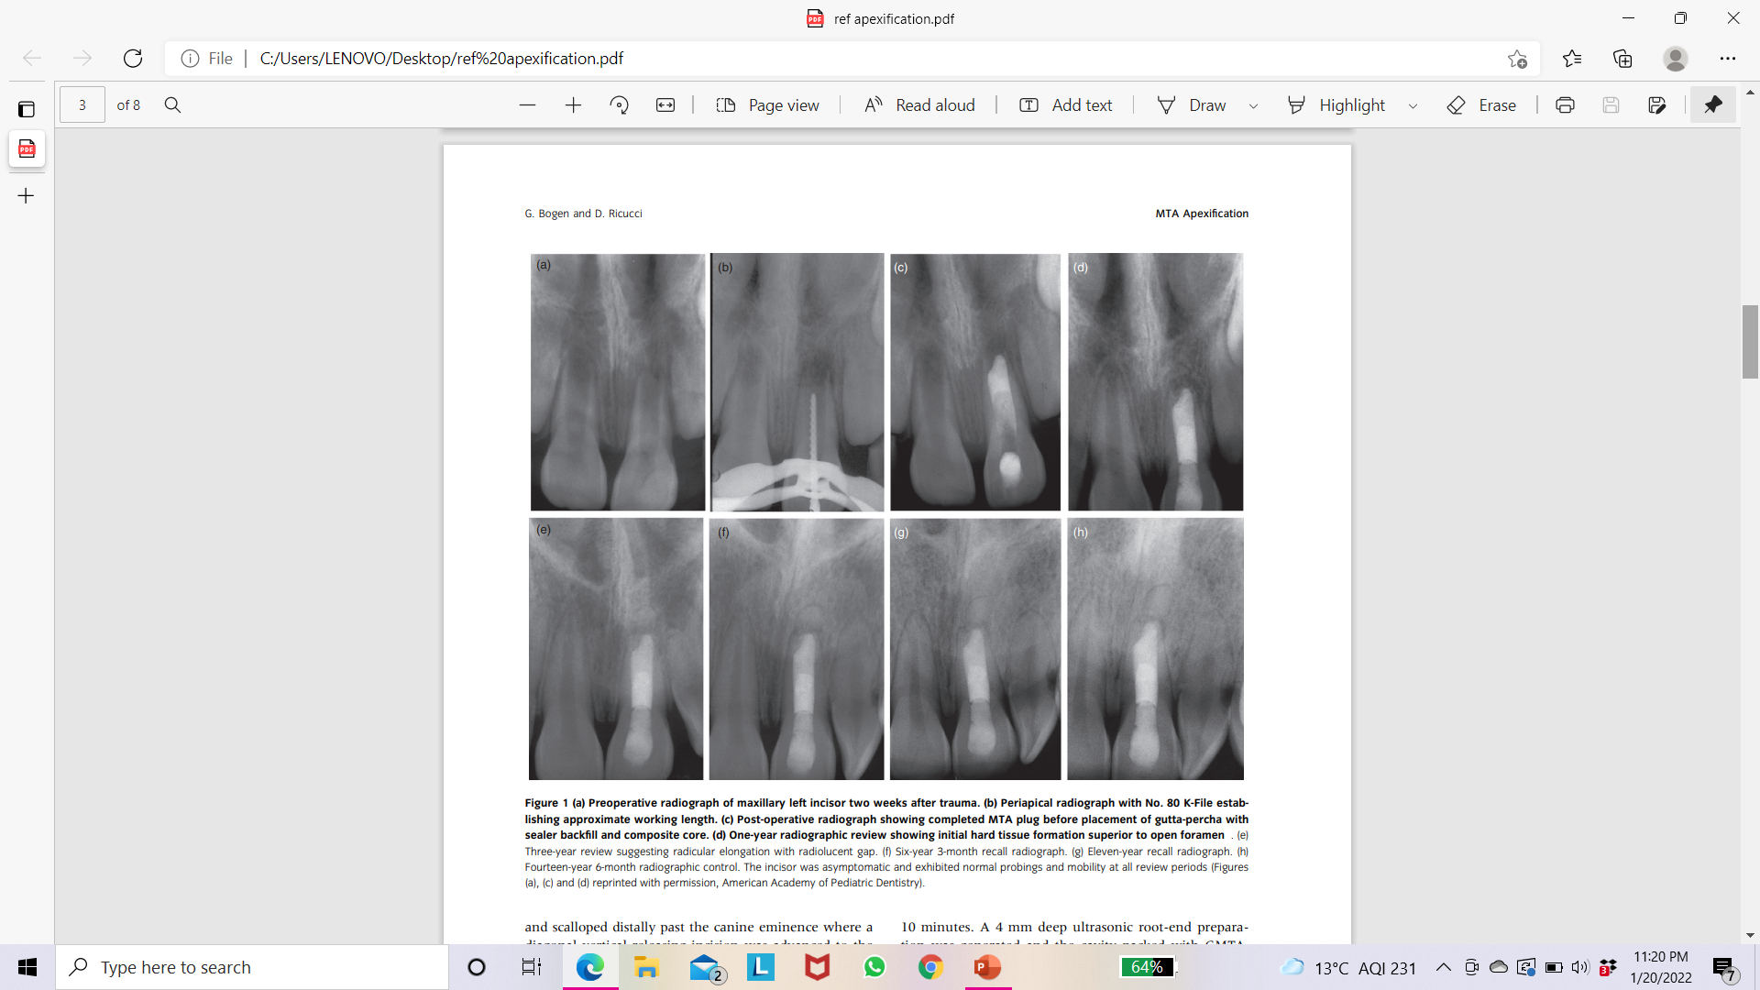

Slide 12
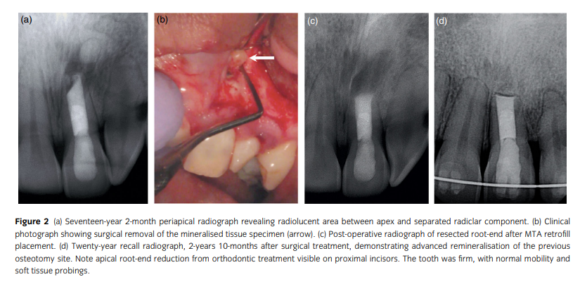

Slide 13
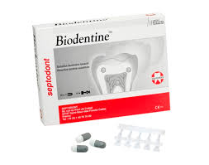
BIODENTINE
A new calcium silicate-based material, Biodentine, has been introduced.
It has been developed as a permanent dentine substitute material whenever original dentine is damaged.
Powder- tricalcium silicate and dicalcium silicate- the principal component of Portland cement and MTA. Calcium carbonate, calcium oxide, iron oxide, and zirconium oxide.
Liquid-calcium chloride and a water-soluble polymer.

Slide 14
Properties

Slide 15
Han and Okiji (2011) compared calcium and silicate uptake by adjacent root canal dentine in the presence of phosphate buffered saline using Biodentine and ProRoot MTA.
The results showed that both materials formed a tag-like structure composed of the material itself or calcium- or phosphate rich crystalline deposits.
The thickness of the calcium and silicate -rich layers increased over time, and the thickness of the calcium and silicate -rich layer was significantly larger in Biodentine compared to MTA after 30 and 90 days, concluding that the dentine element uptake was greater for Biodentine than for MTA.

Slide 16
Apical Closure in Apexification: A Review and Case Report of Apexification Treatment of an Immature Permanent Tooth with Biodentine
(J Endod 2016; 42(5): 730-734)
This report describes the case of a 9-year-old boy who was referred to the Department of Dental Clinic of Quer- etaro Autonomous University of Mexico.
One month prior the patient had suffered a dental trauma of his upper left central incisor and had been treated by another dentist. The clinical diagnosis was previously initiated therapy and symptomatic apical periodontitis. The treatment was apexification with Biodentine.
At follow-ups performed at 3, 6, and 18 months after treatment the tooth was asymptomatic.
The cone-beam computed tomography scan at 18-month postoperative follow-up revealed continuity of periodontal ligament space, absence of periapical rarefactions, and a thin layer of calcified tissue formed apical to the Biodentine barrier.
On the basis of sealing ability and biocompatibility, apexification treatment with Biodentine was applied in the present case report. The favorable clinical and radiographic outcome in this case demonstrated that Biodentine may be an efficient alternative to the conventional apexification materials.

Slide 17
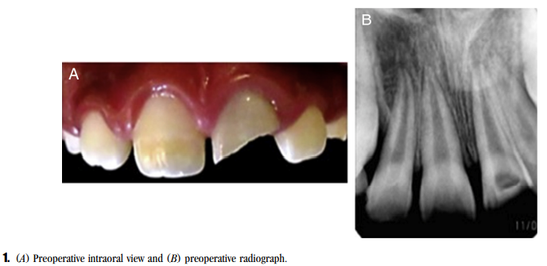
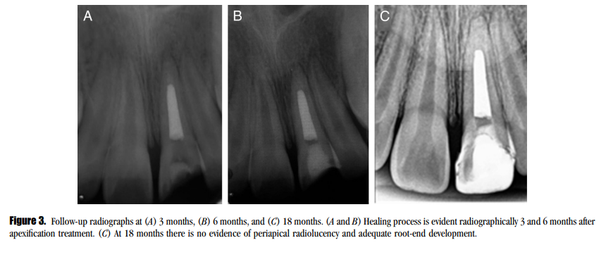
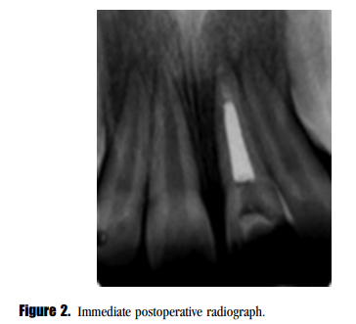

Slide 18
Comparison of the Success Rate of Mineral Trioxide Aggregate, Endosequence Bioceramic Root Repair Material, and Calcium Hydroxide for Apexification of Immature Permanent Teeth: Systematic Review and Meta-Analysis
J Pharm Bioallied Sci. 2021 Jun;13(Suppl 1):S43-S47
All the three materials had almost similar success rate in terms of clinical symptoms, but the time taken for apical barrier formation and also single visit treatment makes MTA and Endosequence BCRRM superior to calcium hydroxide. Studies comparing EndoSequence Root Repair Material and MTA are very limited and need further evaluation in the future.
Results
The success rate in both bioceramic and MTA was 93.3% and 90%, respectively, with no statistically significant difference.

Slide 19
Conclusion
The practitioner should strive to achieve root development through apexogenesis wherever possible.
If this treatment fails or pulp is necrotic, apexification should be initiated. However, the most important factors are debridement of the canal and closure of this space with a suitable material.
These aspects allow the body to reorganize and repair the periapical tissues.

Slide 20
Take home message
The practitioner should strive to achieve root development through apexogenesis wherever possible.
If this treatment fails or pulp is necrotic, apexification should be initiated. However, the most important factors are debridement of the canal and closure of this space with a suitable material.
These aspects allow the body to reorganize and repair the periapical tissues.

Slide 21
QUESTION & ANSWERS
WRITE A NOTE ON APEXIFICATION?
WRITE A NOTE ON APEXOGENESIS

Slide 22
References
J Conserv Dent. 2018 Sep-Oct; 21(5): 462–465.
Tandon S. Textbook of Pedodontics. 2nd ed. Delhi: Para; 2008.
Apexification: A systematic review
Apical Closure in Apexification: A Review and Case Report of Apexification Treatment of an Immature Permanent Tooth with Biodentine
Mineral trioxide aggregate apexification: a 20-year case review
Comparison of the Success Rate of Mineral Trioxide Aggregate, Endosequence Bioceramic Root Repair Material, and Calcium Hydroxide for Apexification of Immature Permanent Teeth: Systematic Review and Meta-Analysis
J Pharm Bioallied Sci. 2021 Jun;13(Suppl 1):S43-S47

Slide 23
Suggested reading
Endodontic practices - Grossman
Pathways of pulp – Cohen
Textbook of Endodontics – Nisha Garg
Endodontics - Ingle

Slide 24
THANK YOU!

